Slide 1


SALES PERFORMANCE ANALYSIS
X
Bank Muamalat - Business Intelligence Analyst
Project Based Internship
Batch Juni 2025
Presented by: Agil Tri Widianto

Slide 2




About Me
I am a graduate of Biology Education from Surabaya State University. Currently, I am interested in changing careers to data analysis, data administration, or other relevant fields. I have good communication skills, am able to work in a team, adapt quickly, and have effective time management. I am also developing skills in data processing using spreadsheets, Microsoft Excel and other data processing tools such as SQL, Power BI and Tableau.
agilwidianto92@gmail.com
https://www.linkedin.com/in/agil-tri-widianto-888077320/

Slide 3
Case Study
As a Business Intelligence Analyst at PT Sejahtera Bersama, I will analyze the sales data from January 2020 to December 2021. Based on the available detailed transaction data, this analysis will lead to strategic recommendations that the company can implement to maintain or improve its sales performance in the future

Slide 4
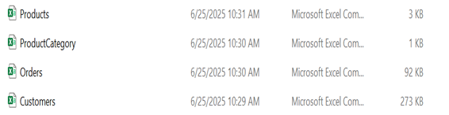
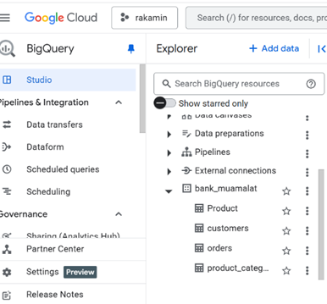
Collect and SetUp Data Sets
The dataset used is PT Sejahtera Bersama sales data for the period January 2020 to December 2021. The dataset consists of four main tables, namely Products, ProductCategory, Orders, Customers.
Upload to Google BigQuery and create a database with the name, bank_muamalat

Slide 5
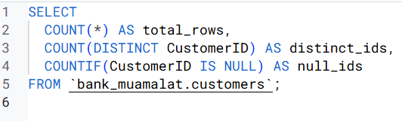

Primary Key
To determine the column in a table that can be a primary key by looking at its uniqueness and NULL values.
Conclusion: total_rows = distinct_ids and null_ids = 0, then the Customer id column in the Customers table is the PrimaryKey
So the Primary Key in each of these files is:
Customers Table = CustomerID
Orders Table = OrderID
Product Table = ProdNumber
Product_category = CategoryID

Slide 6
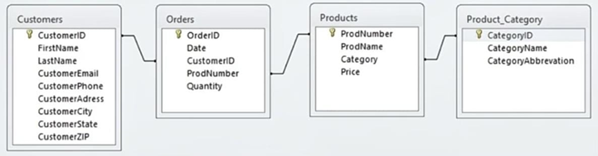
Relationship Table
Products Table
Primary Key: ProdNumber
Foreign Key: Category
Product Category Table
Primary Key: CategoryID
Customers Table
Primary Key: CustomerID
Orders Table
Primary Key: OrderID
Foreign Key: CustomerID, ProdNumber
So the Relationship Between Tables is:
• Customers to Orders relationship is one to many
• Products to Orders relationship is one to many
• Product Category to Products relationship is one to many

Slide 7
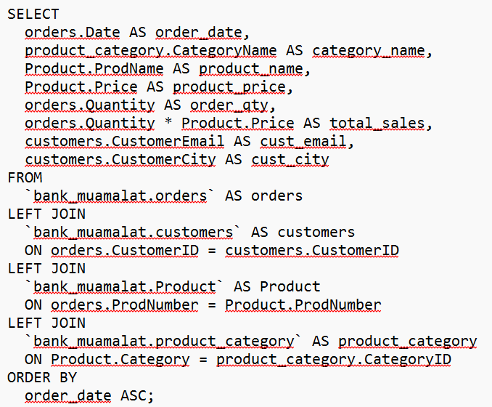
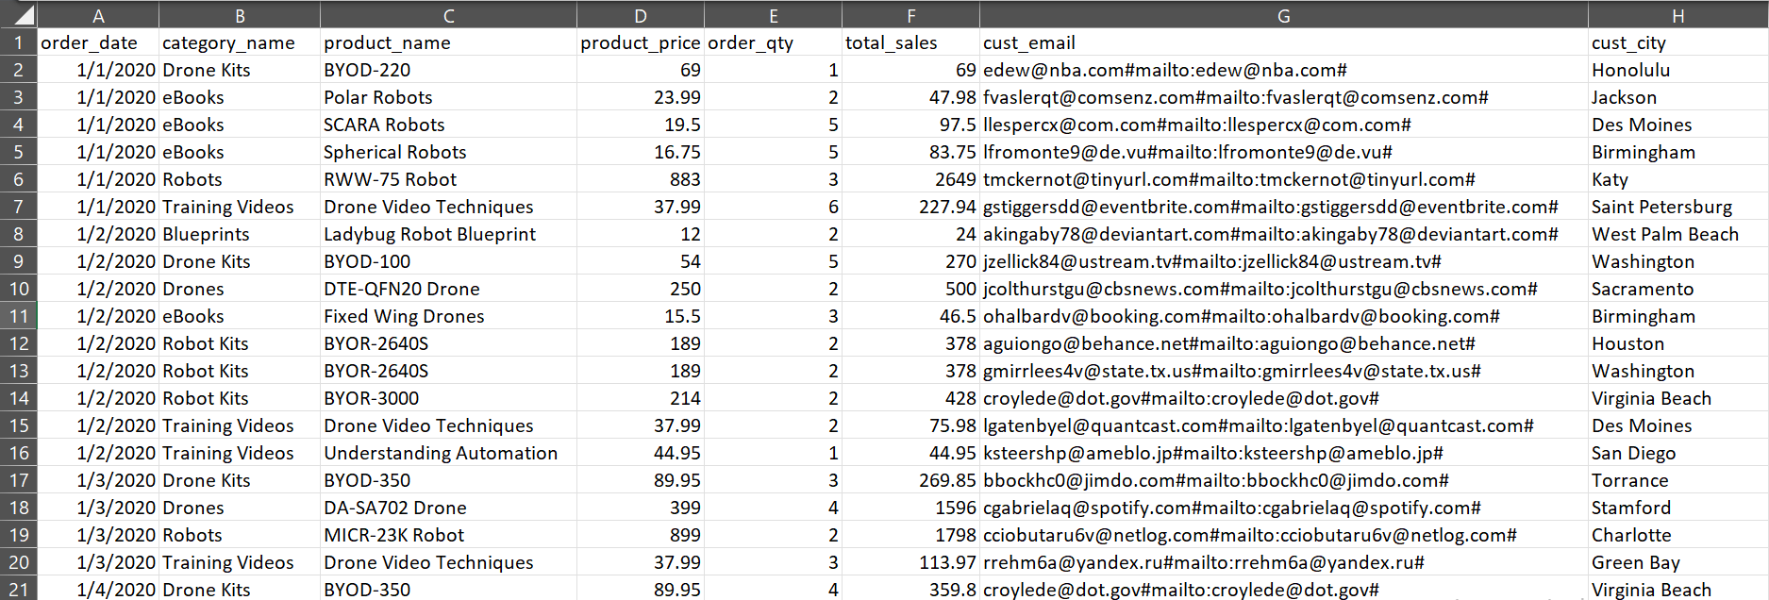
Table Master
Query to create master table:
Query
Query Results

Slide 8
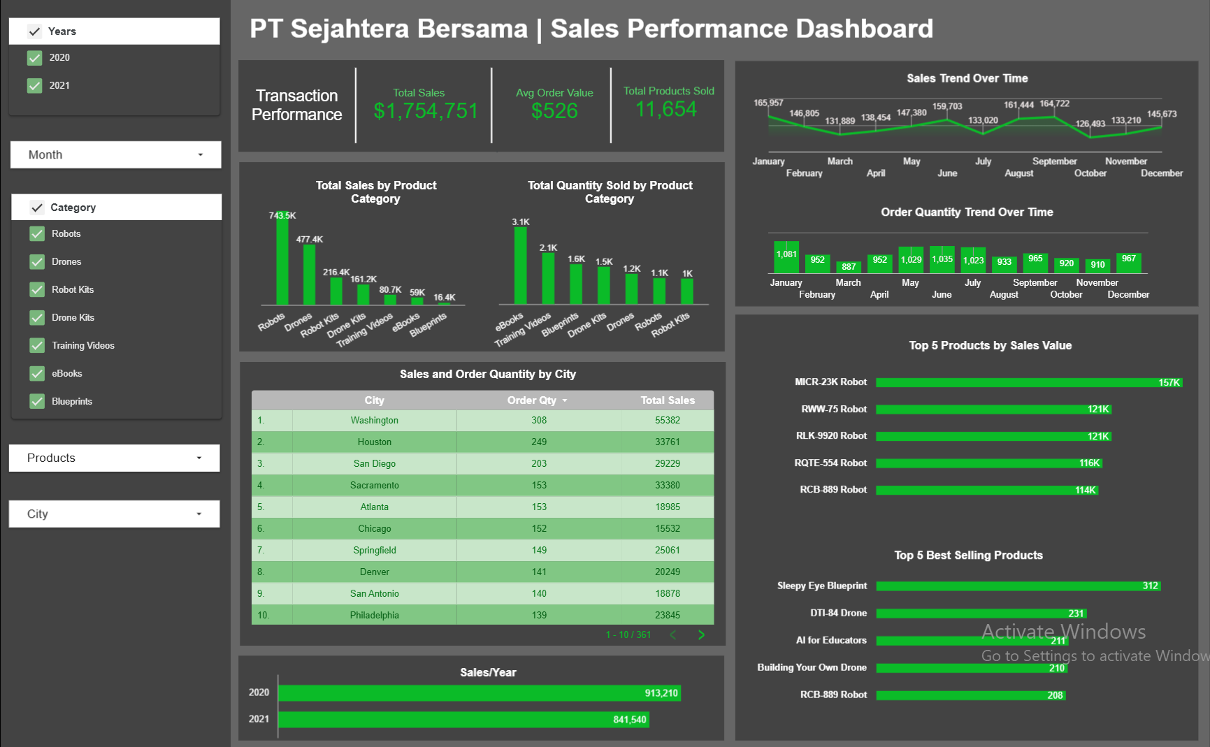
Dashboard
Dashboard title is Sales Performance Dashboard

Slide 9
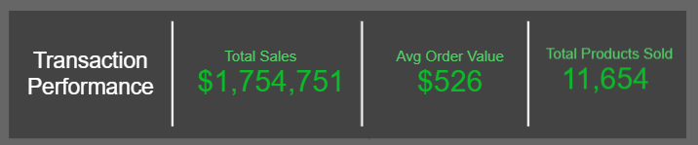
Findings
•Total Sales reached $1,754,751 with a total of 11,654 units sold.
•The average transaction value was $526, indicating the product has
a relatively premium price.

Slide 10
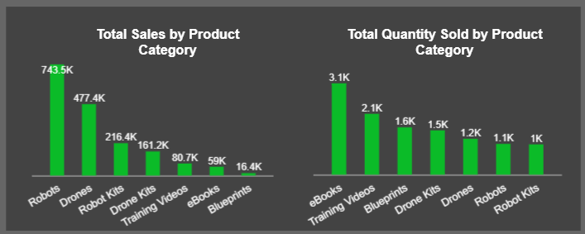
Findings
•The categories with the highest sales by value were:
Robots: $743.5K
Drones: $477.4K
•The categories with the highest quantity:
eBooks: 3.1K units
Training Videos: 2.1K units

Slide 11
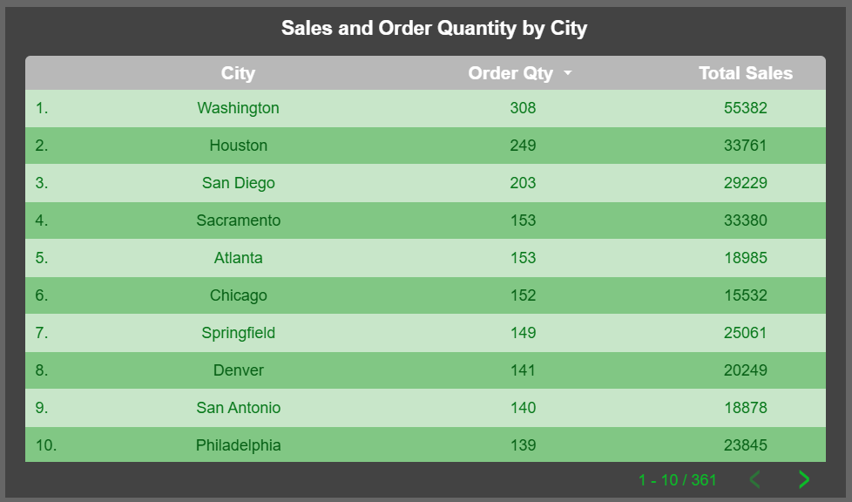
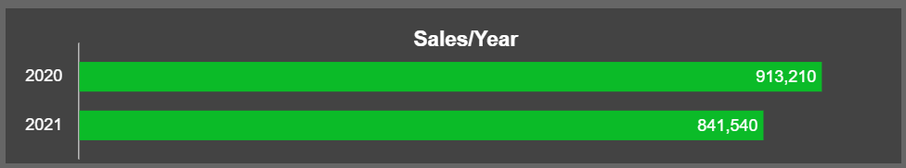
Findings
•City with the largest sales contribution: Washington: $55,382 (308 orders)
•The year with the highest total sales (revenue) was 2020

Slide 12
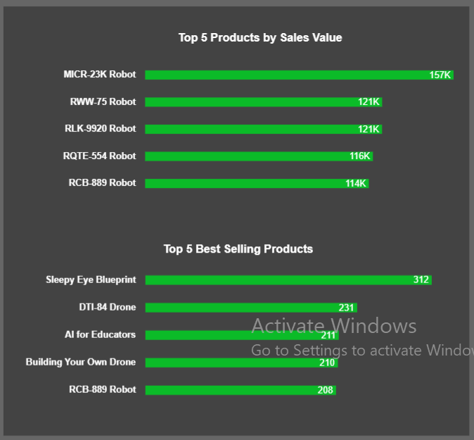
Findings
•Product with highest sales:
MICR-23K Robot: $157K
•Product with highest quantity:
Sleepy Eye Blueprint: 312 units

Slide 13
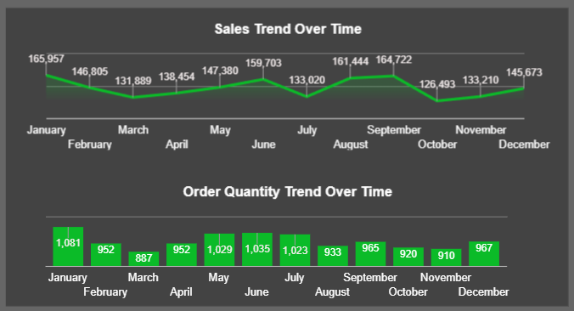
Findings
•Monthly trends (sales and quantity) fluctuate, with peaks or highest in Q1 in January ($165,957) and Q3 in September ($164,722). The worst decline occurred in Q4 in October ($126,493).

Slide 14
Insight
•High-priced categories such as Robots and Drones generate large sales despite lower quantities.
•Low-priced categories such as eBooks and Blueprints sell well in units but contribute little to total revenue.
•Big cities such as Washington and Houston dominate sales, indicating strong market potential in urban areas.
•Popular products are not necessarily the most profitable, for example: Sleepy Eye Blueprint sells very well but is not in the top 5 sales values.
•The decline in sales in the final quarter of the year (Q4) needs to be considered, there is a potential that the end-of-year campaign has not been maximized.

Slide 15
Business Recommendations
A. Product Strategy
•Increase stock and promotion for top performer products, such as MICR-23K Robot and RNW-75 Robot.
•Develop product bundling: combine high quantity products
(eBooks, Training Videos) with high-value products
(Robots/Drones) to increase average order value.
B. Regional Strategy
•Marketing focus in top cities (Washington, Houston) that have
proven to have high demand.

Slide 16
Business Recommendations
C. Time/Season Strategy
•Launch promotions around October–November, as data shows a
significant decline during Q4.
•Create loyalty programs or end-of-year discounts to drive sales
around Christmas and New Year.

Slide 17
Important Links:
Github link for final submission file:
https://github.com/agiltriwidianto/FinalTask_BankMuamalat_BI-Analys_Agil-Tri-Widianto
Presentation Video Link:
https://drive.google.com/drive/folders/18vYTAv5Jl9TXLcboR0ewKG0jPmrt_JQX?usp=sharing

Slide 18


THANK YOU

